Slide 1
Opinion Mining for Products

Slide 2
Abstract
The growth of E-commerce has led to the invention of several websites that market and sells products as well as allows users to post reviews. It is typical for an online buyer to refer to these reviews before making a buying decision.
Hence, automatic summarization of users’ reviews has a great commercial significance. However, since the product reviews are written by non experts in an unstructured, natural language text, the task of summarizing them is challenging.
This Project presents a semi supervised approach for mining online user reviews to generate comparative feature-based statistical summaries that can guide a user in making an online purchase. It includes various phases like preprocessing and feature extraction and pruning followed by feature based opinion summarization and overall opinion sentiment classification.
Empirical studies indicate that the approach used in the paper can identify opinionated sentences from blog reviews with a high average precision of 91% and can classify the polarity of the reviews with a good average accuracy of 86%.

Slide 3
Introduction
The Internet offers an effective, global platform for Ecommerce, communication, and opinion sharing. It has several blogs devoted to diverse topics like finance, politics, travel, education, sports, entertainment, news, history, environment, and so forth. on which people frequently express their opinions in natural language.
Mining through these terabytes of user review data is a challenging knowledge engineering task. However, automatic opinion mining has several useful applications. Hence, in recent years researchers have proposed approaches for mining user-expressed opinions from several domains such as movie reviews, political debates, restaurant food reviews, and product reviews, and so forth Generating user-query specific summaries is also an interesting application of opinion mining. Our focus in this paper is efficient feature extraction, sentiment polarity classification, and comparative feature summary generation of online product reviews.
Nowadays, several websites are available on which a variety of products are advertised and sold. Prior to making a purchase an online shopper typically browses through several similar products of different brands before reaching a final decision. This seemingly simple information retrieval task actually involves a lot of feature-wise comparison and decision making, especially since all manufacturers advertise similar features and competitive prices for most products.

Slide 4
Continued
However, most online shopping sites also allow users to post reviews of products purchased. There are also dedicated sites that post product reviews by experts as well as end users. These user reviews if appropriately classified and summarized can play an instrumental role in influencing a buyers’ decision.
The main difficulty in analyzing these online users’ reviews is that they are in the form of natural language. While natural language processing is inherently difficult, analyzing online unstructured textual reviews is even more difficult. Some of the major problems with processing unstructured text are dealing with spelling mistakes, incorrect punctuation, use of non dictionary words or slang terms, and undefined abbreviations. Often opinion is expressed in terms of partial phrases rather than complete grammatically correct sentences. So, the task of summarizing noisy, unstructured online reviews demands extensive Preprocessing.
In this paper, we apply a multistep approach to the problem of automatic opinion mining that consists of various phases like Preprocessing, Semantic feature-set extraction followed by opinion summarization and classification. The Multiword based approach for feature extraction used in the paper offers significant advantages over other contemporary approaches like the Apriori based approach and the seed-set expansion approach. Our approach significantly reduces the overhead of pruning compared to the Apriori-based approach and does not require prior domain knowledge for selecting an initial seed-set of features like the seed-set expansion approach. We have demonstrated empirically that the approach proposed in the paper can identify opinionated sentences from blog reviews with a high average precision of 91% outperforming the other two feature extraction strategies. The multistep approach can also classify the polarity of the reviews with a good average accuracy of 86%.

Slide 5
Proposed System
In this section we will explain the system design of the opinion summarizer cum classifier implemented by us. We generated an opinion review database by crawling Some popular websites that categorically post product reviews by actual users. As shown in Figure 1, our product opinion summarizer has three main phases. These phases are
(1) preprocessing phase,
(2) feature extraction phase, and
(3) opinion summarization and classification phase.

Slide 6
System Architecture Diagram

Slide 7
Hardware & Software requirements
Hardware
Software
1 GB RAM.
200 GB HDD.
Intel 1.66 GHz Processor Pentium 4
Windows XP, Windows 7,8
Visual Studio 2010
MS SQL Server 2008
Windows Operating System

Slide 8

System Working Screenshots

Slide 9
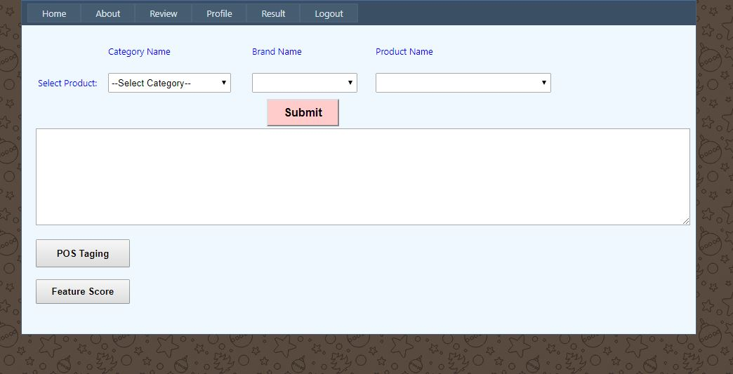
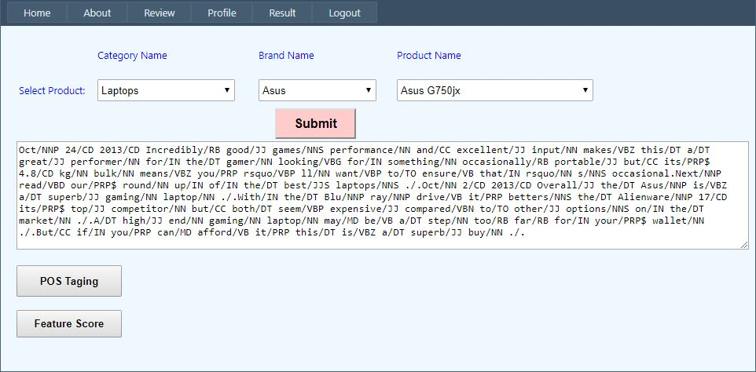

Slide 10
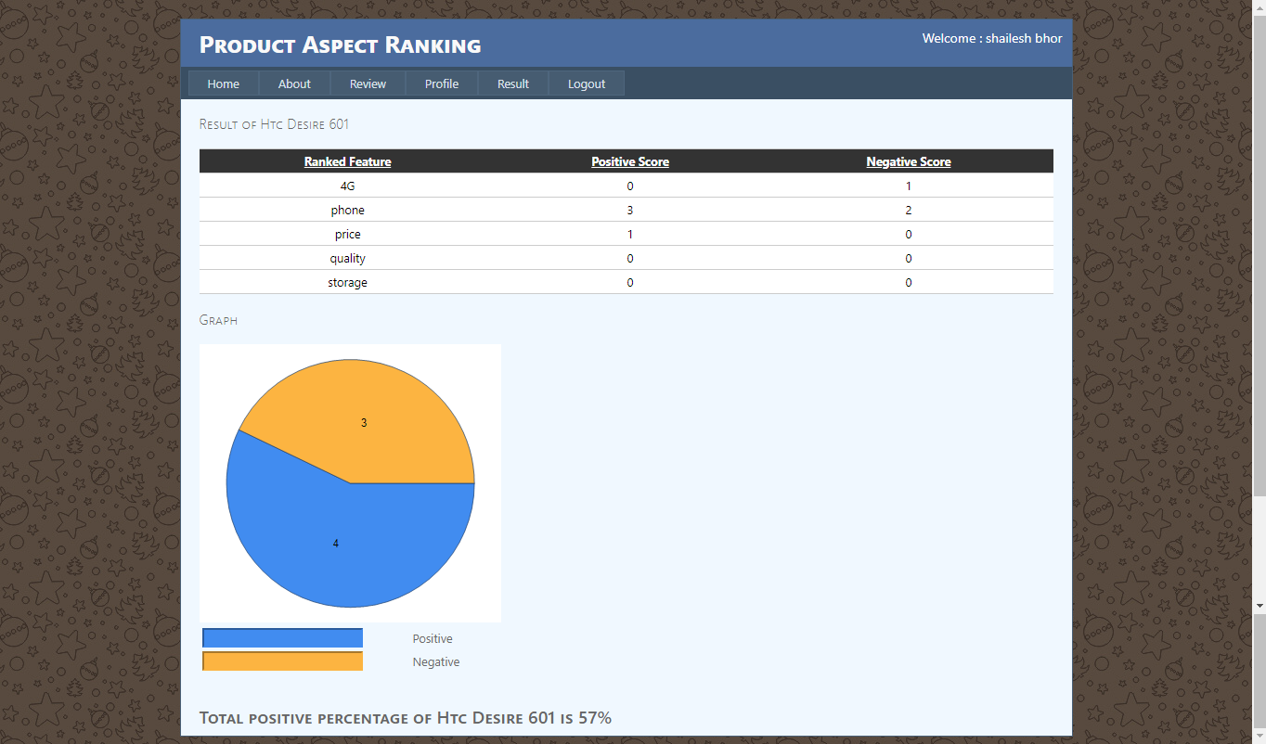

Slide 11
Conclusion
Classifying and summarizing opinions of bloggers has several interesting and commercially significant applications. However, this task is much more difficult than classifying regular text and requires intensive Preprocessing. The success of the opinion mining task is mainly dependent on the efficiency and sophistication of the Preprocessing and feature extraction steps.
We empirically proved that the proposed approach for product feature set extraction, that is, using frequent multi words with decomposition strategy outperforms other contemporary approaches like the Apriori-based approach and the seed-set expansion approach.
Empirical results indicate that the multistep feature based semi supervised opinion mining approach used in this project can successfully identify opinionated sentences from unstructured user reviews and classify their orientation with acceptable accuracy. This enables reliable review opinion summarization which has several commercially important applications.

